Slide 2
What is digital? Org chart etc
What is cloud?
What is GE PDS doing?
GE Application examples
What is in it for this centre? Rather engineers in GE?
What is an API
Python basics
What is Flask
Reference links to apps demoed
Predix beta registration
Cloud foundry installation and familiarisation

Slide 3
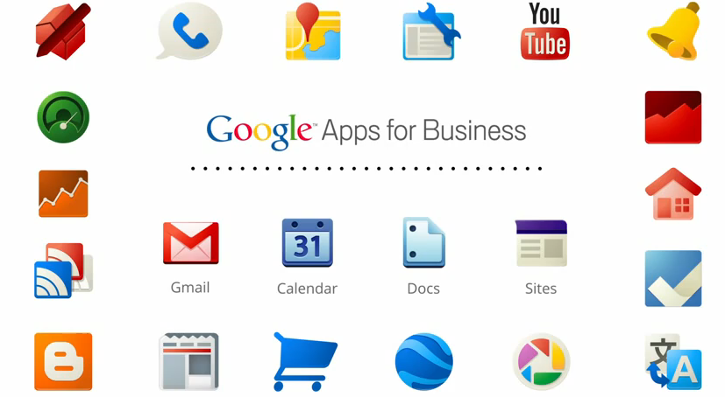
Courtesy: http://whitehatsme.com/wp-content/uploads/2014/03/Benefits-of-Google-Apps.png

Slide 4
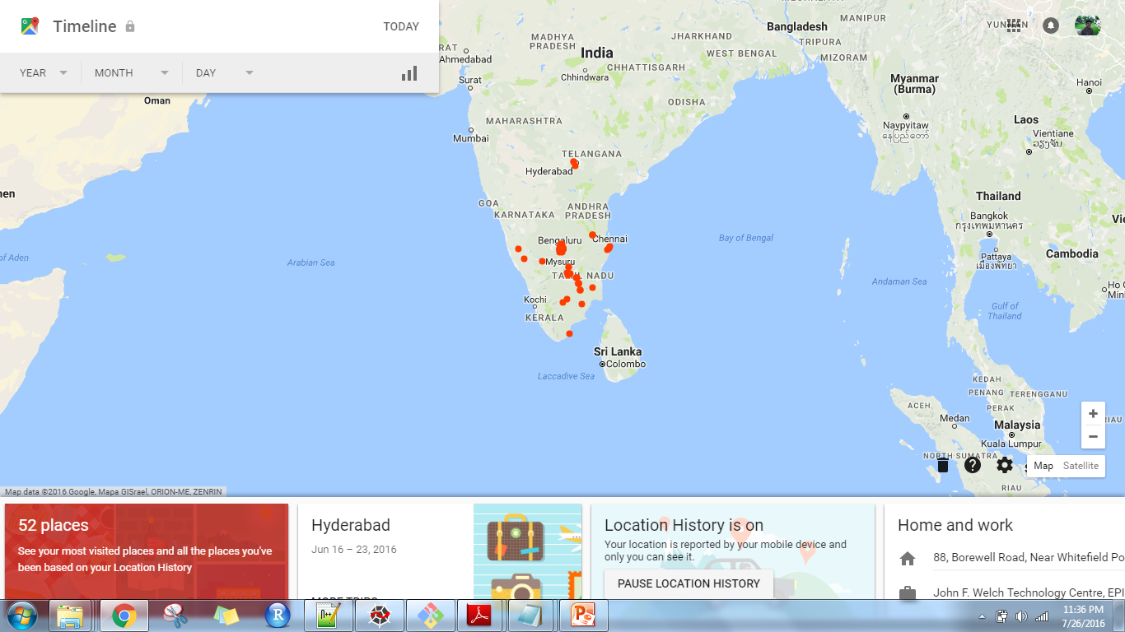
https://www.google.com/maps/timeline?authuser=2

Slide 5
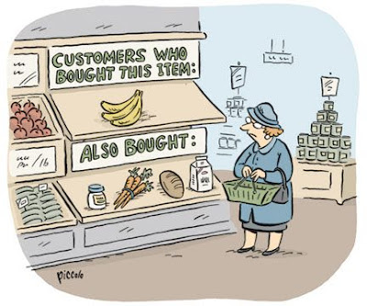
They know what you want before you do…

Slide 6
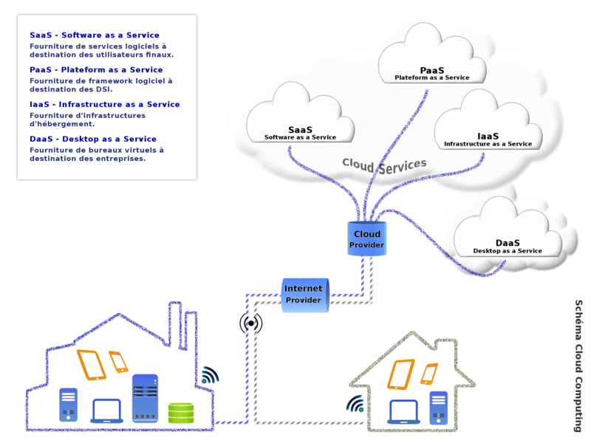

Slide 7
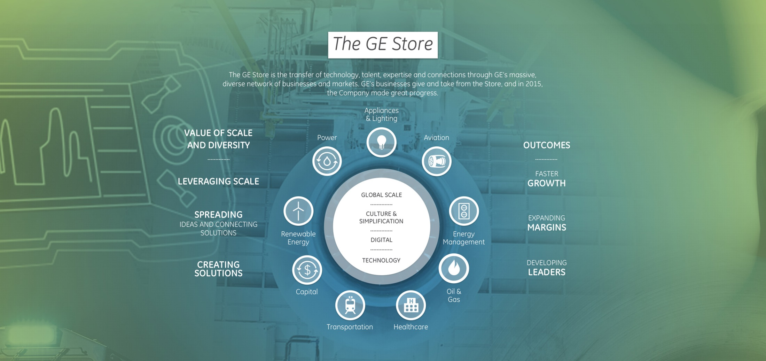
GE Digital…

Slide 8
Digital Wind Farm

Slide 9
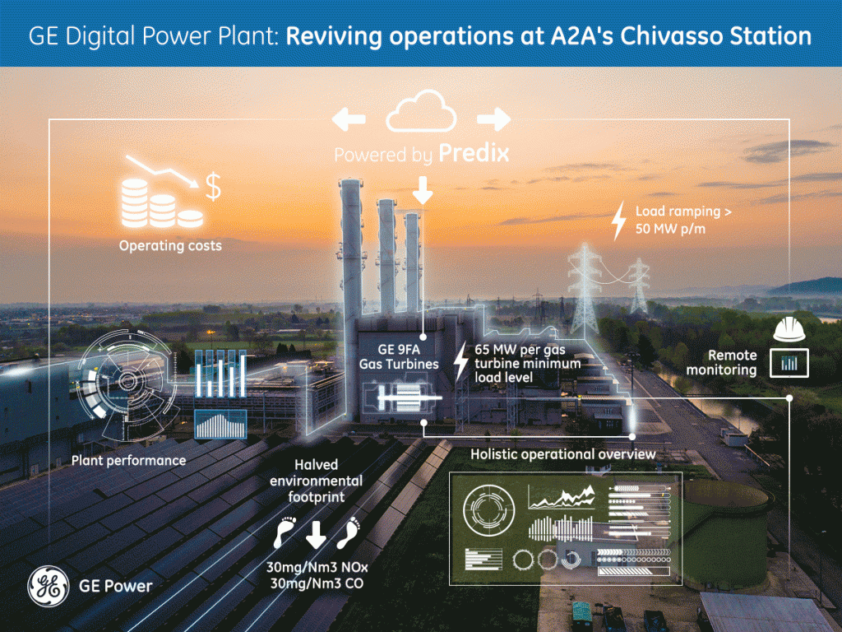

Slide 10
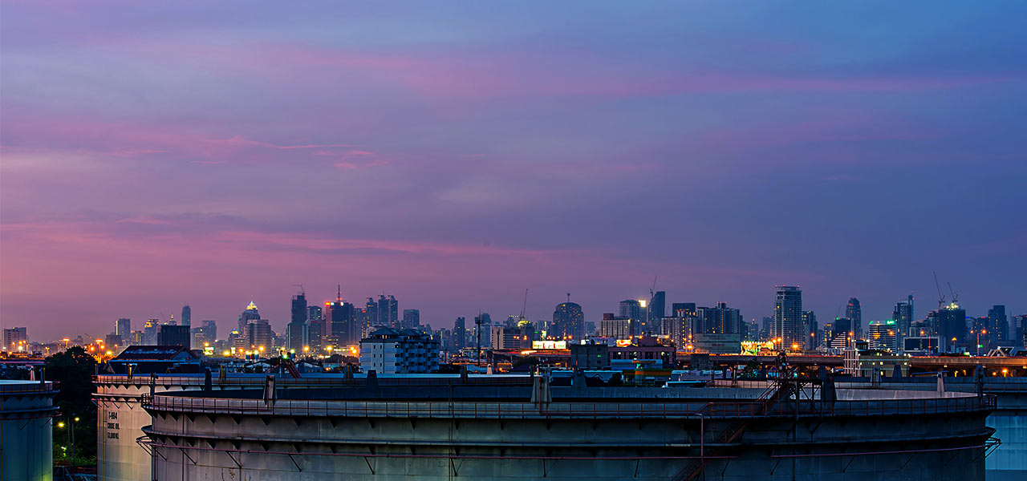
GE Digital Solutions Example…

